Slide 1
Hepatitis Viruses
INTRODUCTION
Definition
Types

Slide 2
INTRODUCTION
The term ‘viral hepatitis’ refers to a primary infection of the liver by any one of a heterogeneous group of ‘hepatitis viruses’.
Hepatitis viruses are taxonomically unrelated.Except for type B which is a DNA virus all the others are RNA viruses.
Hepatitis may occur incidentally during many other viral infections, such as with yellow fever, Lassa fever, cytomegalovirus, EB,herpes simplex ,varicella zoster,measles,rubella viruses. These are not included in the category of viral hepatitis.

Slide 3
Definition
Hepatitis is an inflammation of the liver.the condition can be self limiting or can progress to fibrosis, cirrhosis or liver cancer.Hepatitis viruses are the most common cause of hepatitis.

Slide 4
Types
TYPE A HEPATITIS
TYPE B HEPATITIS
Type C HEPATITIS
TYPE D HEPATITIS
TYPE E HEPATITIS

Slide 5
TYPE A HEPATITIS
Type A hepatitis is a subacute disease of global distribution, affecting mainly children and young adults.
Clinical Features
Fever
Malaise
Loss of appetite
Diarrhea
Nausea
Abdominal discomfort
Dark coloured urine
Jaundice
Caused by HEPATITIS A VIRUS

Slide 6
Hepatitis A Virus (HAV)
HAV is a 27 nm nonenveloped RNA virus .
Genome-7500 nucleotide long
Family-picornaviridae
Genus-Hepatovirus

Slide 7
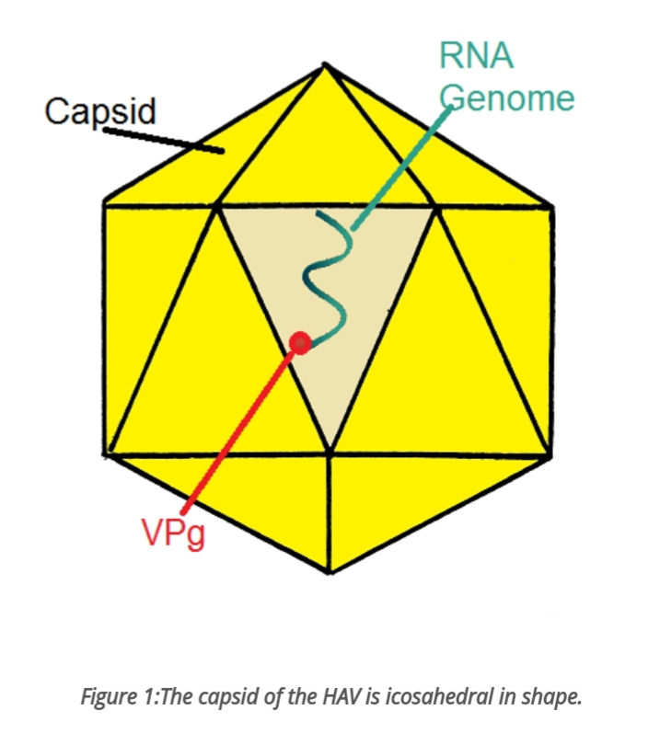
Structure of Hepatitis A virus

Slide 8
Epidemiology
Natural infections with HAV is seen only in humans.
transmission –
Fecal-oral route
Person to person contact
Poor sanitization
Contaminated food or water
Infection is by ingestion.

Slide 9
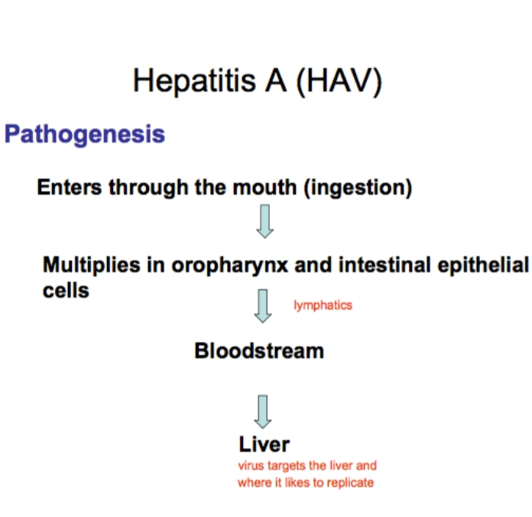

Slide 10
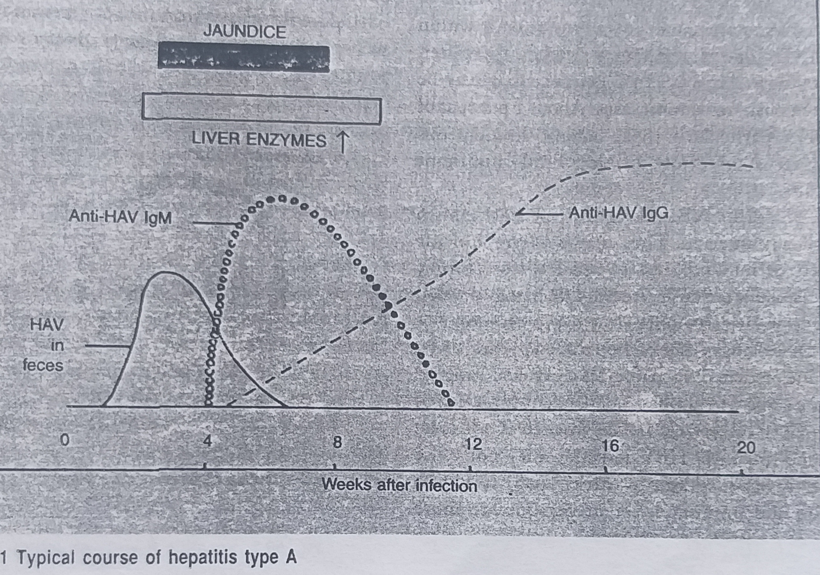

Slide 11
Laboratory diagnosis
Etiological diagnosis of type A hepatitis may be made by demonstration of the virus or its antibody.
antibodies-Anti-HAV IgM ,Anti-HAV IgG
Serologic test-
Immune electron microscopy
Complement fixation
Radioimmunoassy
ELISA
IMMUNE ADHERENCE HEMAGGLUTINATION

Slide 12
Prophylaxis
1.General prophylaxis
Improved sanitary practices
Prevention of fecal contamination of food and water
2. Specific Passive prophylaxis by pooled normal human immunoglobulin IM,before exposure or in early incubation period.
3.No specific antiviral drug is available.

Slide 13
References
MEDICAL MICROBIOLOGY BY ANANTNARAYAN
https:/ /www.ncbi.nlm.nih.gov
https //study.com

Slide 14
Thank you

